Slide 1

Data Science project: Aphasia
KB-74
Notes:
We want to start off with an example of our progress in our team, we did get some knowledge from datacamp and coursera .

Slide 2
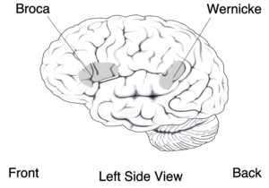
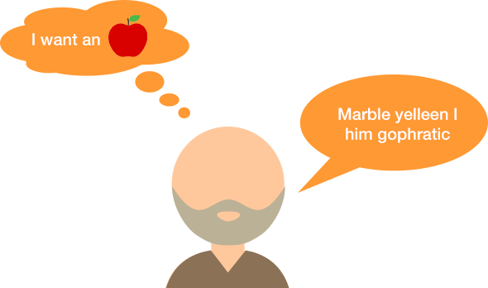
Aphasia
speech to text
Goal of the project: Create a speech to text software that can successful translate speech from aphasia patients to text.

Slide 3
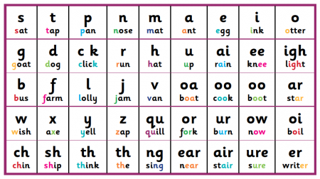
What is a phoneme ?
What is a diphoneme?

Slide 4
Classify phoneme boundary
Audio → Diphonemes
Diphoneme classifier

Slide 5
What we did this week?
Kaldi toolkit(speech recognition library)
Research about classifiers for phoneme boundaries (SVM, LSTM, RNN)
Looked at the coding of the files in the Diphone database of MPI.
Looking for a Research paper for a close reading session.
Creating a feature extraction pipeline.

Slide 6
Feature extraction pipeline
Continuous speech
Frame blocking
Windowing
Cepstrum
Mel frequency
FFT

Slide 7
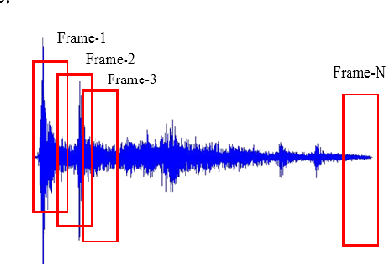
Frame blocking
Frame blocking with length of 10 miliseconds.
Notes:
Frames van 10 miliseconden pakken om ervoor te zorgen dat je niet de fft over het hele signaal doet

Slide 8
Feature extraction pipeline
Continuous speech
Frame blocking
Windowing
Cepstrum
Mel frequency
FFT

Slide 9
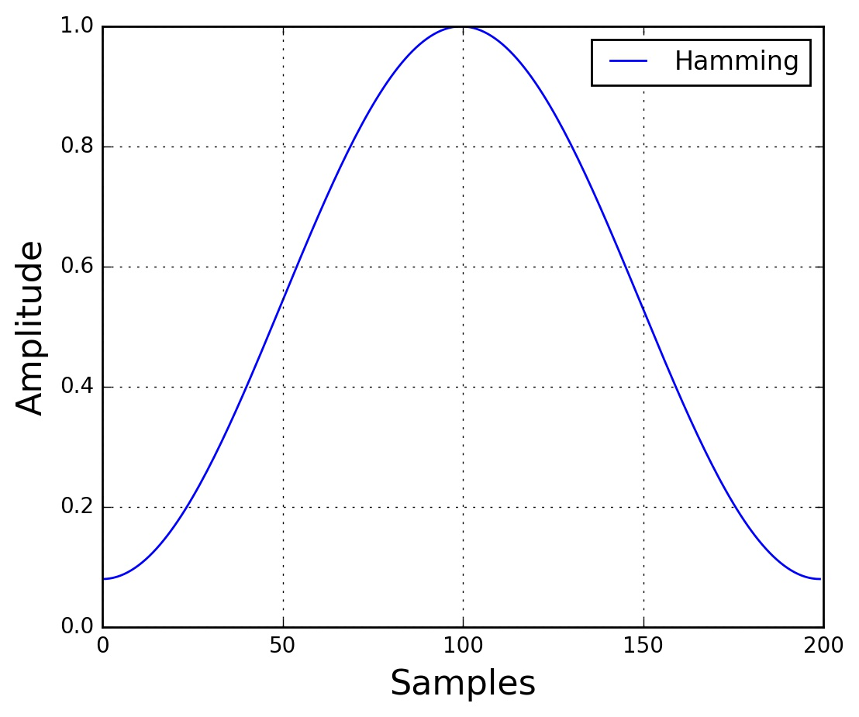
Windowing (hamming window)
The main reasons to apply Hamming window:
to counteract the assumptions made by FFT
That the data is infinite
And reduce the spectral leakage
Notes:
Windowing passen we toe om ervoor te zorgen dat data, om oneindige gegevens tegen te gaan. En om spectrale lekkage te verminderen.

Slide 10
Feature extraction pipeline
Continuous speech
Frame blocking
Windowing
Cepstrum
Mel frequency wrapping
FFT

Slide 11
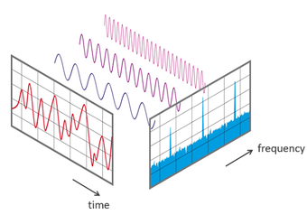
FFT (Fast Fourier Transform)
To calculate the frequency spectrum of each frame:
From time to frequency.
Notes:
We can now do an NN-point FFT on each frame to calculate the frequency spectrum, which is also called Short-Time Fourier-Transform (STFT),
where NN is typically 256 or 512, NFFT = 512; and then compute the power spectrum (periodogram) using the following equation:

Slide 12
Feature extraction pipeline
Continuous speech
Frame blocking
Windowing
Cepstrum
Mel frequency
FFT

Slide 13
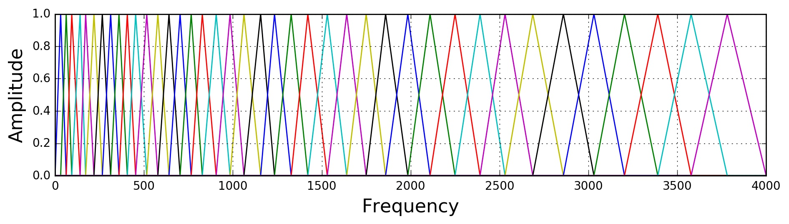
Mel frequency wrapping
Too much information in normal frequencty
Human speech is between [300.3000]HZ
k=number of mel spectrum coefficients=20
Notes:
Filterbank with triangular bandpass frequency responseLinear frequency spacing <1000 Hz<Logarithmic frequency spacingHuman Speech
Є
BL{300, 3000} Hzk=number of mel spectrum coefficients=20

Slide 14
Feature extraction pipeline
Continuous speech
Frame blocking
Windowing
Cepstrum
(MFCC)
Mel frequency
FFT

Slide 15
Cepstrum
DCT(Discrete cosine transform): converts the Mel-spectrum coefficients back to time domain.
Provides a good representation of the local spectral properties for a given frame
Output is a set of coefficients called acoustic vector
Notes:
DCT: converts the mel spectrum coefficients back to time domain
Provides a good representation of the local spectral properties for a given frame
Output is a set of coefficients called an acoustic vector

Slide 16
Questions?

